Slide 1
Estimating QoS with ML Filip Krasniqi & Jocelyne Elias

Slide 2
Introduction
Estimating QoS is a hard problem
The space exploration is composed of a lot of parameters: topology, number of nodes, routing policy, traffic intensity, traffic distribution…
It means that we are learning the relation between the QoS metrics and all these features!
About Machine Learning
Supervised Learning problem - Regression
We choose Deep Learning (DL) as the Machine Learning family
Most of these features are not even easy to describe in a way s.t. DL techniques can handle with them
Notes:
A configuration is an instance of the space exploration params.
Remind that configuration = instance of …

Slide 3
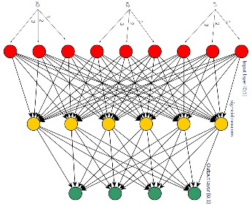

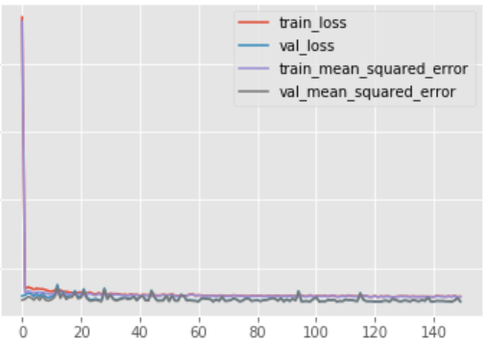
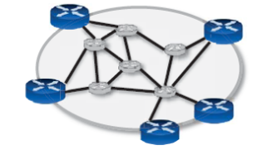
1) SoA: Understanding the modeling of Delays using NN
Simulation tool: OMNeT++.
To collect a matrix of M rows, the simulation is run for M periods
During each period, for each pair of nodes the traffic characteristics are obtained
Strenghts
Falls
Model is built only considering the traffic matrix. No learning based on the configuration (topology & routing)
Accurate in complex scenarios
Fast and light-weight
Big advantage wrt simulations
Different results with different topologies and routing schemes ➔ direct/high dependence
Give great information on how far could NN give to estimating QoS
Generalization under different situations is analyzed, to understand when a model should be retrained and when not
No online learning
Data-driven approach: high dependence on data (as a ML technique) ➔ data must be reliable. Not true in the networking field, as they are simulated
Fixed size of input to NN
Results reported after subtracting the unavoidable variance. Not clear how they did this ➔ so our results cannot be really compared
Big advantage wrt queuing theory
All datasets are available
Good baseline for QoS estimation
Data
Model (1)
Results
Shared repos
Knowledge Defined Networking: http://knowledgedefinednetworking.org
Collection of repositories related to the work
Complexity of model increases together with intensity
Robust to change of routing policy
Robust to change of topology
Traffic intensity varies -> prediction accuracy worsened
Sigmoid
NxN hidden layers
ES with maximum epochs: 7,500,000
Adam Optimizer
MSE with L2 regularization
Space exploration
Data
Number of packet drops (input)
Bandwidth (Kb/s) in the period (input)
NxN matrix
Delay per packet (sec/packet), target
NxN matrix
Configurations
Topology
Star, ring, free
Traffic characteristic
Intensity
Distribution
Routing policy: SP, MAN, POOR
Network size: 5, 10, 15 nodes
Notes:
Direct approach for estimating.
Main contributions:
Guideline
understand under which conditions it is necessary to change the model
Ability to evaluate well on unseen data, as also confirmed by our implementation. Confirmation that DL suits well this problem

Slide 4
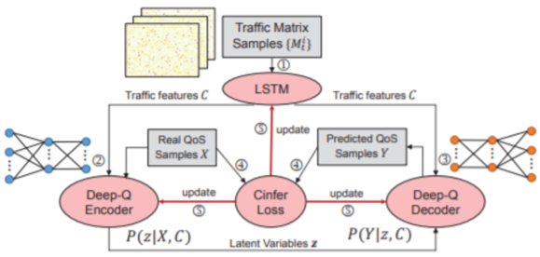

2) SoA: Traffic-driven QoS Inference using Deep Generative Network
Real data (24h sampling from real nets)
No shared repos
Strenghts
Falls
Model is built only considering the traffic matrix. No learning based on the configuration (topology & routing)
No proof that it is able to generalize over different networks
Model is improved in every aspect if compared to the previous paper
A comparison with other DL techniques is shown
Improvement in QoS estimation context
Tried on two different network configurations ➔ worked ok
Chance to find correct trade-off between inference time and loss (L)
Learning from real data
Feature selection simplifies input
Dynamic configuration of input nodes
No routing policy assumption
No online learning
Model: DeepQ
Results
Bigger congestion -> more complex model
Capability of adjusting tradeoff between optimal and training time with L
Capability of learning on different networks
Not great results…
… but able to adapt to different sizes
DeepQ is the best between queuing theory models, VAE and GAN.
Confirmation that critical points of VAE and GAN would give bad results in this context.
Data
Basic structure: VAE
LSTM to adapt input structure of DeepQ to the one of VAE
From space X to Z
Decoder trained to directly model P(Y|z,C)
No Wasserstein distance, instead Cramer distance approximated with Cinfer Loss
Space exploration
Analyze
current
state-of-art
Data
Traffic matrix
Delay
Configurations
Traffic intensity (low, medium, high)
Topology (Overlay vs Data Center Network)
Variational Autoencoder (VAE)
Generative Adversarial Network (GAN)
These techniques are described as not suitable in their current form
Long Short Term Memory networks (LSTM)
Notes:
Generative approach.
Check better how LSTM works, what are matrices {M(1),…,M(L)}
Explain why VAE, GAN are not suitable -> need to compute the Wasserstein distance. Computationally unfeasible -> GAN is great in doing that with adversarial model but unstable training performance (= no monotonically decreasing curve due to the need of a long training).
DeepQ is able to learn the distribution of the output wrt the input data (generative approach). So, it predicts well when changing number of nodes, but it does not learn from the network configuration

Slide 5
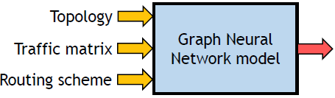
3) SoA: Unveiling the potential of Graph Neural Networks
Simulation tool: OMNeT++.
Same approach as in 1)
Shared repos and datasets as in 1)
Strenghts
Falls
No online training
Model is improved in every aspect if compared to the previous papers
Able to learn topology and routing thanks to the graph nature of the network
Provided Relational inductive bias
All datasets available
Not clear
how links and paths are related to the MPNN configuration
how they were able to test it under different configurations (readout is a NN)
Results
Low error for delay
Jitter model: partially trained from delay model
Transferable learning: model learned for delay led to great results also for jitter
Great generalization results even when changing the network configuration (unseen network)
Showed use cases in different combinations with an SDN
Model: Routenet
QoS
Data
Basic structure: MPNN
Adapted algorithm to accept in input network information, obtained from network and routing
Path state
Link state
Improved MPNN by use of
GRU
SELU
Space exploration
Analyze
current
state-of-art
Data
Traffic
Delay
Network
Routing
Configurations
Traffic intensity
Topology (14 nodes vs 24)
Routing (different routing tables)
Graph Neural Networks
Message Parsing Neural Networks (MPNN)
Notes:
Direct approach, but feature selection thanks to the MPNN algorithm.
RouteNet is able to learn with different nodes configuration (but the readout is described as just a simple NN…). It is able to learn the structure of the network and gives the best performance among all

Slide 6
Motivations (1/2)
Ideal model
Able to predict well on unseen data with same configuration -> paper 1)
Able to predict well on different configurations
Learn the distribution of the output wrt the input data -> DeepQ
Learn the structure of the network -> RouteNet
Able to adapt to changes of the network
No one is implemented to adapt when required

Slide 7
Motivations (2/2)
What we want to do?
About the data
Understand well the relationship between the configuration of the network and the model
-> (paper 1) Analyze which features can be relevant to the problem
By using ns3, simulate different networks to really understand the capability of the generalization of the models
About the model
Implement the algorithms to confirm the critical points of what described so far
Big number of features -> encoding (DeepQ) and attention
Learn evolution over time -> Recurrent NN (DeepQ)
Compare the algorithms to other techniques.
-> Graph Convolutional Networks
-> Non-local neural networks
Combine both known and novel algorithms.
Eg: RouteNet is able to learn at first from the network configuration, then from the data, that is provided as raw. Algorithms such that DeepQ and RouteNet can thus be combined
Notes:
About data
Understand well -> I mean contextualize the problem of QoS modeling in DL. Paper 1 did this by analyzing in different configurations by defining a general space of exploration. Plus, in case of a NN representing the model, complexity of the model should depend on the complexity of the model, so for example the bigger the computer network, the bigger the NN (they added layers)
Analysis on input from existing datasets -> I mean analyze their datasets and compare to what we thought
Feature analysis -> in general, think about what features can be added/removed. Eg: I removed bw_x_x, add per link dropped packets, add queue information. Adding features requires more deeper learning with better learning (eg: feature selection, encoding, attention) or more data when training.

Slide 8

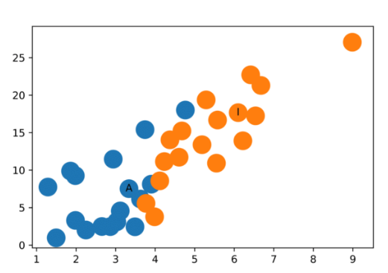
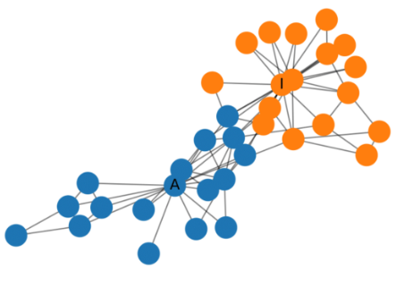
Graph Convolutional Networks
General application of CNN
Input data: matrix
Data is both the cell itself and the relationship with neighbors (distance)
Two cells are close if they are adjacent
Graph Convolutional Network (GCN)
Locality computed with graphs. Semi-supervised learning algorithm.
Unsupervised step: given information about the network (eg: adjacency matrix), nodes are clustered by providing different weights. No training in this step.
Then train with the labeled data
Convolution in QoS? No application until now.
Problem in networking: representation is with graphs -> locality should be represented in a different way.
Homophily: connected nodes tend to be similar
GCN
References
Simple implementation
More detailed explanation
Application on classification
MNIST classification
Deep learning on graphs

Slide 9



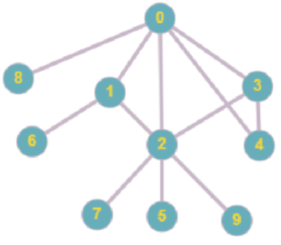
Our contributions
Dataset analysis
traffic, delay, absolute number of dropped packets in that period. No details
Paper 1)
Data representation can be improved because
More convenient to store bandwidth and delay per link
Delay per packet is not a great information, being that the packet size can vary. Either provide the absolute delay given in input the packet size (may become too complex to learn that way), or consider the delay per bit
DeepQ
Traffic matrix, delay. No details
Same as paper 1, plus dropped packets per link, percentiles over the packets, routing matrix and network configuration (number of nodes, links). Traffic is Kbps, delay is average over the packets
Routenet
Implementation of paper 1)
Exact implementation
Improvement
Tried under different configurations
Parameter tuning
Considerations when adding TD and intensity in input
Simulations
Interaction between ns3 and python to fill the dataset given a configuration.
Ability to change the network in terms of nodes, links between them (that define a p2p connection) and communications
Notes:
When talking about the exact implementation / improvement, underline that some aspects were not clear, eg: early stopping -> how was it working? Training: it has been done only on one dataset? Because if not it would suggest why a simpler model is better. Plus, remind that the error they provide cannot be compared

Slide 10
Next steps
Short term goals
Build our own datasets in different configurations
Test RouteNet
Improvement on DL techniques
Encoding for feature extraction
Attention
RNN
Implement GCN in QoS estimation context
Delay estimation
Other tracks to follow
Implement DeepQ and test it
Implement Non local Neural Networks in QoS estimation context
Step by step comparison of the proposed techniques
Combine when possible the techniques keeping the major benefits

